Slide 1
Silencing the
social media jungle

Slide 2
say
what?

Slide 3
The words of the reckless pierce like swords, but the tongue of the wise brings healing.
Proverbs
12:8

Slide 5
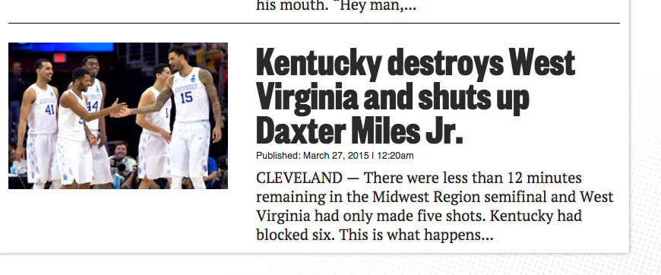

Slide 6
5 rules to:
Build
Communication
champions
Radiate energy
Be Genuine
Offer insight
Capture imaginations
substance

Slide 7
Don’t give power away
Compete
For it!
Bring your “offense”
Have your own agenda
Play “defense”
Block & Bridge
Maximize media formats
TV: 20 sec answers, visuals say it all!
Radio: 7 sec. sound bytes, voice makes impact
Print: Longer answers, provide more content/insight, but understand that they will only use a sentence or two, paint picture with you words
Internet: “Wild West” immediacy

Slide 8
Measure results by…
Clarity of your message
persuasiveness
1
2
Prominence of your point of view
connection made person to person
3
4

Slide 9
controlling interviews
Focus on the positive
Pause & Breathe
Listen
think
Speak
Downplay the negative

Slide 10
QUESTIONERS

Slide 11
1
The Buddy
Types of Questioners
- Overly Friendly; only objective is “get the story”
- Know what you are and are not willing to say
2
Machine Gunner
- Rapid fire questions
- Pause, think, take your time
Be Friendly, Not friends
3
Dart Thrower
- Poison questions
- Never repeat negatives, bridge to your message
4
Lobber
- Starts easy to throw you off
- Stay conversational, don’t let your guard down
5
Hesitant
- Long pauses, waits for answers
- Stop when you are finished, don’t get sucked in

Slide 12
QUESTION pitfalls
Getting trapped by emotional words or phrases
The questions
don’t hurt you.
The answers do!
Don’t fully listen to the question being asked
Get defensive
Stiffen up, fidget, or look away.
Letting the format of the question box you in
Tell me the two worst things about being in this show…
Most people give two because they are asked for two

Slide 13
Off the record
No such thing!

Slide 14
QUESTIONS

Slide 15
three
biggest
traps
Hypothetical questions
Phrasing of questions
Negative / emotional words
“If the team continues to be plagued by injuries…”
Never an upside to answering these questions
“Give me two reasons why…”
Don’t get boxed in by format
“You’re old, tired, and can’t deliver…”
Don’t stop listening, bridge to your position

Slide 16
answers

Slide 17
Strategy to gain power
Key message
=
influence
Never just answer questions
Have your key message
Say it easily, say it often
Intentionally incorporate it in remarks
Focus on positive, downplay negative

Slide 18
blocking
& bridging
Block reporters’ focus
then say…
“What I can tell you is...”
“In fact…”
“What I’m saying is…”
“The most important thing is…”
“However…”
bridge
Their question
Your message

Slide 19
A
Confirms that the reporter is listening
Benefits of
bridging
B
Helps control the interview
What is the greatest
benefit of the “bridging technique”?
c
Ends the interview politely
D
Makes you seem more approachable

Slide 20
ABC Formula
For handling difficult questions
Acknowledge their opinions / emotions without agreeing with them
A
“I understand why they might think that…”
Bridge to your point of view
B
“…but the board’s goal was to…”
Concisely state your key message
C

Slide 21
Pocket guide
to avoiding misquotes
Take time to think
20 second rule
Be Precise
Don’t be baited
Avoid Jargon
Don’t let your guard down
Only add detail if there’s time, interest,
need
General answers convince no one
Losing your cool loses power
Use words casual fans understand
You’re always on

Slide 22
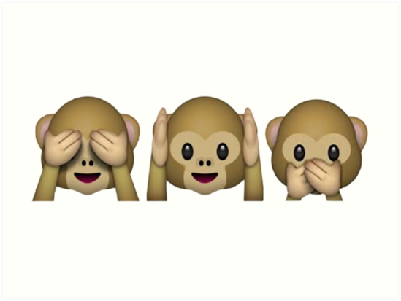
See No
Hear no
speak no

Slide 23
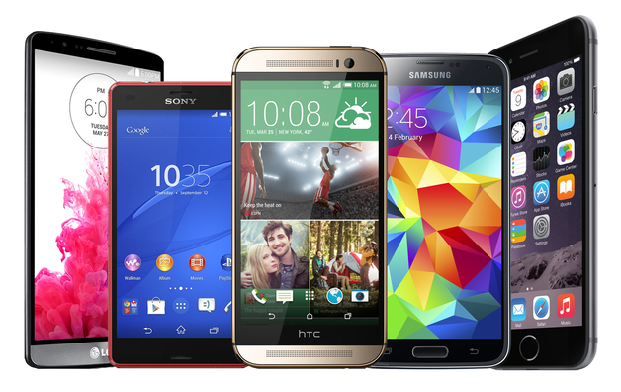
Connected society
The rise of the smartphone
of American adults now own a smartphone of some kind, up from 35% in the spring of 2011.
A majority of smartphone owners use their phone to follow along with breaking news, and to share and be informed about happenings in their local community.
64%
use their phone to share pictures, videos, or commentary about events happening in their community, 35% doing so frequently.
67%
of smartphone owners used text messaging at least once over the course of the study period
97%
of cell owners find themselves checking their phone for messages, alerts, or calls – even when they don’t notice their phone ringing or vibrating.
67%

Slide 24
Facebook users
71% of adult internet users
58% of entire adult population
say they use Facebook daily (including 45% who do so several times a day) a significant increase from the 63% who visited daily in August 2013.
70%
of Facebook users frequently or sometimes share, post or comment on Facebook.
65%

Slide 25
Why use social media?
Get the “real story” out
Don’t let rumors run wild
Live where your parents (and students) are living
* Communicate with them how they communicate with each other
Provide a positive social media “role model”
Helps you from relying on traditional media to tell your story
* You may actually get some more earned media because they will see the stories
Provide an official outlet for positive stories from the classrooms/schools

Slide 26
Dealing with
the trolls!

Slide 27
What is a troll?
one who posts a deliberately provocative message to a newsgroup, message board, or social media site with the intention of causing maximum disruption and argument

Slide 28
Engaging
with trolls
Three levels of engagement
1.
Delete / ban user
2.
Hide
3.
respond

Slide 29
Delete / ban user
profanity
Inappropriate subject matter
harassing

Slide 30
hide
Comment only visible to person who posted it and their friends
Others visiting the page can’t see it
“Removes” the comment, but doesn’t inflame

Slide 31
respond
Address legitimate question or concern
Can help serve to spread your message

Slide 32
Social media
Challenges?
1
Time consuming
The vocal minority has an outlet to reach you more easily (anonymously)
2
* Your responses are public; need to have point of contact to be an experienced leader
3
Legal concerns
* Privacy Issues
* Safety

Slide 33
you drive
the bus

Slide 34
Written word
tools
Picture
video

Slide 35
What’s next?
Live video Periscope (owned by Twitter)
Stream concerts,
Classroom presentations
Portions of field trips
Multi-media becomes even more popular
Pictures
Video
Projections:
more than 2 billion users by 2016

